Slide 1

Augmented by,
Ajai John Chemmanam, Anito Anto, Edwin Jose, Chetan Mandloi & Gisha C. G.

Slide 2
Project analysis slide 4
MOTIVATION
& PLANNIG
New to a place & Unclear sign boards
Data collection & training
Randomly distributed buildings & services
Project Objectives
Implementation Plan
Developing APK
Lack of knowledge about services offered.
AR view design & responses

Slide 3


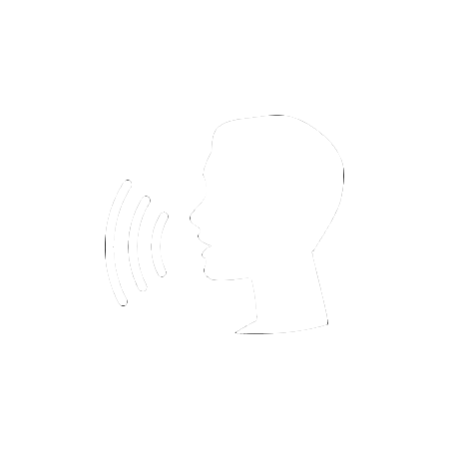
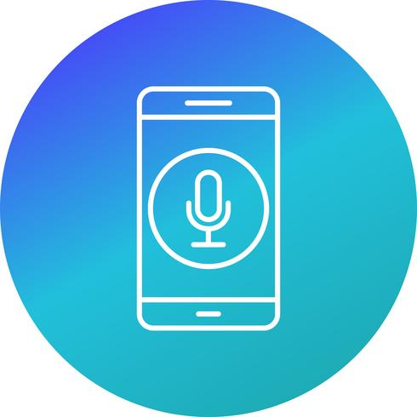




Project analysis slide 2
SERVICES WE
INCLUDE
AI BASED
IDENTIFICATION
GESTURE
RECOGNITION
VOICE SEARCH
MONETIZATION
ARgus
AUGMENTED REALITY
IMAGE IDENTIFICATION
BASED NAVIGATION
NAVIGATION
DESIGN

Slide 4






Project analysis slide 3
TECHNOLOGY
WE INCLUDE
ON-DEMAND MODEL TRAINING
3D IMAGE & VOICE RESPONSE
ARTIFICIAL INTELLIGENCE
AUGMENTED REALITY
NATURAL LANGUAGE PROCESSING
Microsoft custom vision & Amazon sagemaker
Cloud based training
8 landmarks
750 images
3D models-Blender
Navigation signs
Pre-recorded voice files
Voice response of identified buildings.
TensorFlow inference on Amazon EC2 instance.
Receive images
Pre-processing
Landmark identification and classification
AR foundation & Vuforia
AR camera-images
AR based navigation
Support AR Core (Android) & AR Kit (iOS)
Interactive UI
Google Dialog flow
Natural language understanding. Interactive responses
Identify intents and entities.

Slide 5

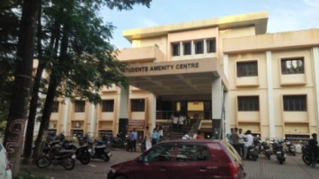
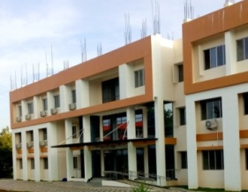
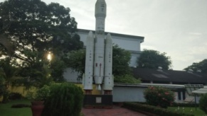
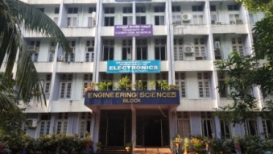






ARCHITECTURE
Recognition
results
Augmented reality
Google
Dialogue flow
Speech/Text
Images to be trained
Voice output
Recognition
Results
Microsoft custom vision
Camera Images
Camera input
MODEL
Gesture input

Slide 6







Human resources slide 7
WE PLAN TO
IMPLEMENT IN
Tourist places
Facilities
AR ads
Virtual bill boards
Offer hotspots
Suggest near by attractions
Hotel booking
Auto Cab facilities
Refreshment places
Rest rooms & other amenities.
Relevant real-time video ads
Store image based price display
Pop-up special offer places on maps

Slide 7
Project analysis slide 6
WE CREATED

Slide 8


HOW WE PLAN
TO GROW
SUCCESS
MONETISATION
COLLABORATE WITH POTENTIAL PARTNERS
ADD DYNAMIC CONTENT
IMPROVE LOCAL CONTENT

Slide 9
Thank You

Slide 10


Slide 11
